Slide 1
Analysing the Effect of Trade Volume on Stock Price
Tahsin Iqbal

Slide 2
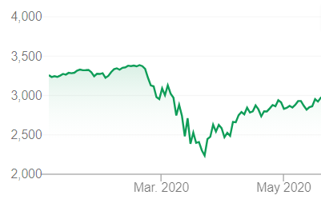
Background
The Covid-19 pandemic caused one the biggest crashes in stock market history
This caused a huge increase in volatility in the market
Air Canada (AC)
June 8: +15.28%
June 9: -10.18%
Bank of Montreal (BMO)
April 29: +5.02%
April 30: -5.44%

Slide 3
Problem
In this environment, there is potential to make big profits day trading volatile stocks.
There is also known to be a relationship between volume of a traded stock and it’s volatility.
Could we use an increase in trade volume during market open as an indicator to buy a stock?
OBJECTIVE: Use historical data to simulate trade entries using volume as the primary technical indicator

Slide 4
Key Assumptions
There are many factors that impact a stock’s price including:
News events
Insider trading
Company Financials
The way we will reduce the bias of these factors in our simulation is to filter our data using several technical indicators.

Slide 5
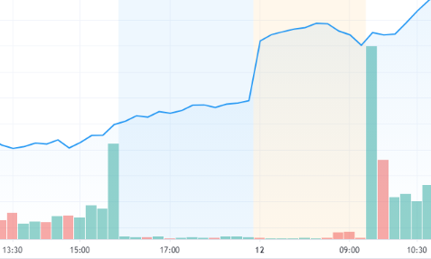
Technical Indicators & Simulation Strategy
Volume Indicator
Trading Volume during first 15 minutes of market open needs to be greater than last 15 minutes of previous market close.
Apple Stock Price Trading Volume

Slide 6
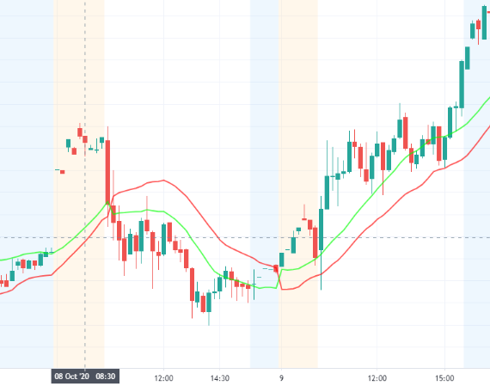
Technical Indicators & Simulation Strategy
Gann HiLo Activator
Green line is rolling average of the maximum value of last 20 candlesticks. If price closes above green line, we are bullish.
Red line is rolling average of the minimum value of last 20 candlesticks. If price closes below red line, we are bearish.
Gives us a better chance of picking upward trending stocks.
Apple Stock Price with Gann HiLo

Slide 7
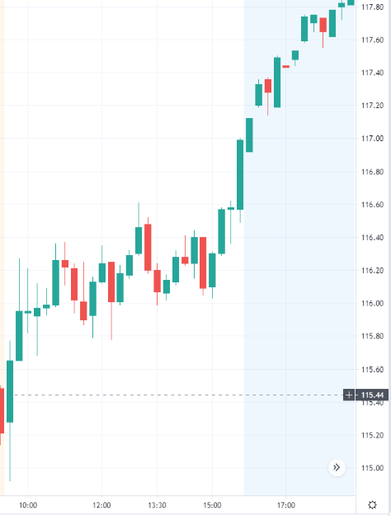
Technical Indicators & Simulation Strategy
Average True Range (ATR):
Takes the average % change (from open to close) of last 14 candlesticks.
Allows us to set limits for when we want to take profit or cut our losses.
We WIN a trade when we make 1 ATR profit
We LOSE a trade when we take 1 ATR losses.
If neither happens, we call it a TIE.
Apple with 1% ATR Target
EXIT
ENTRY

Slide 8
Technical Indicators & Simulation Strategy
Baseline Requirements:
Stock price should open higher than the previous close.
Stock should not have declined in price in the first 15 mins.
Stock should not have already increased in price by 1 ATR.
If a stock passes all of these tests, we will create a trade entry.

Slide 9
Implementation: Data Cleanup
Perform data cleanup and preprocessing of historical data
Filter out pre-market and post-market data
Remove stocks which have less than 85% of maximum possible data points
Remove ‘days’ where there are missing timestamps
Combine datasets

Slide 10
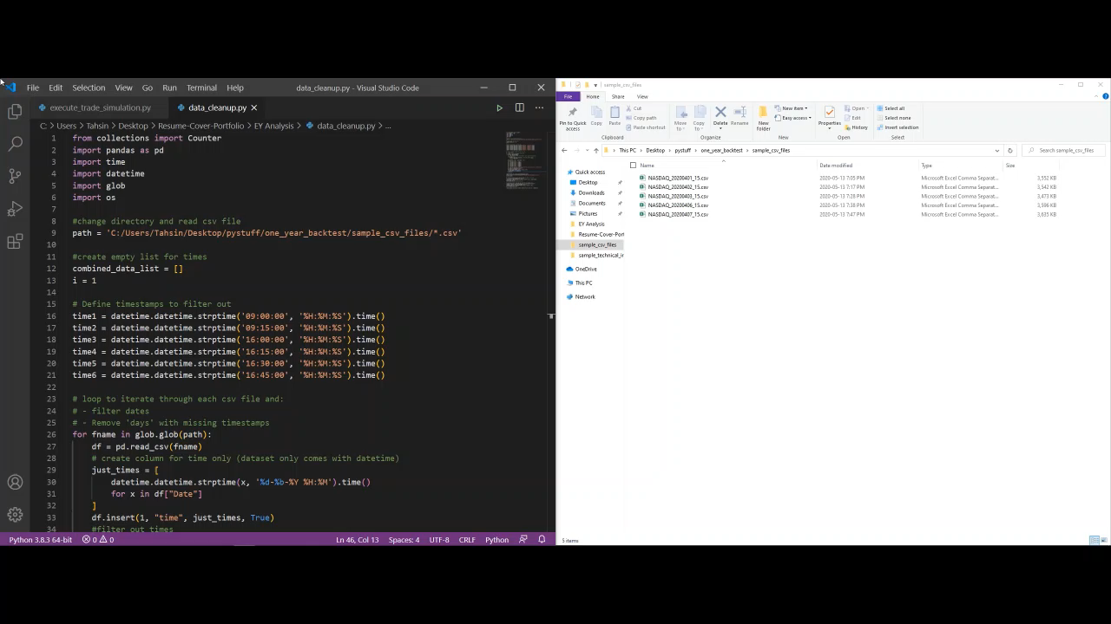
Implementation: Data Cleanup

Slide 11
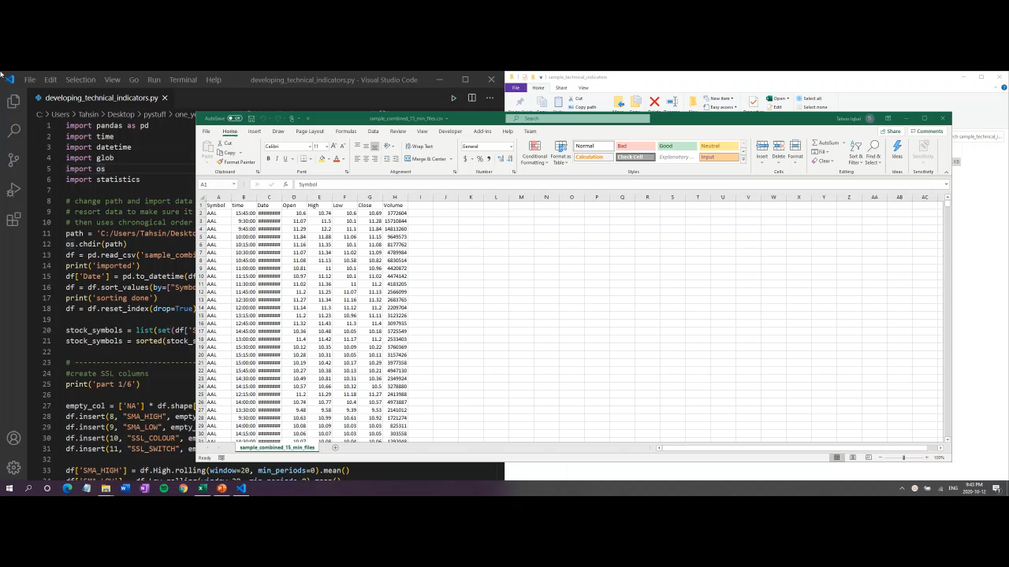
Implementation: Developing Indicators
2. Develop technical indicators and add them to the dataset

Slide 12
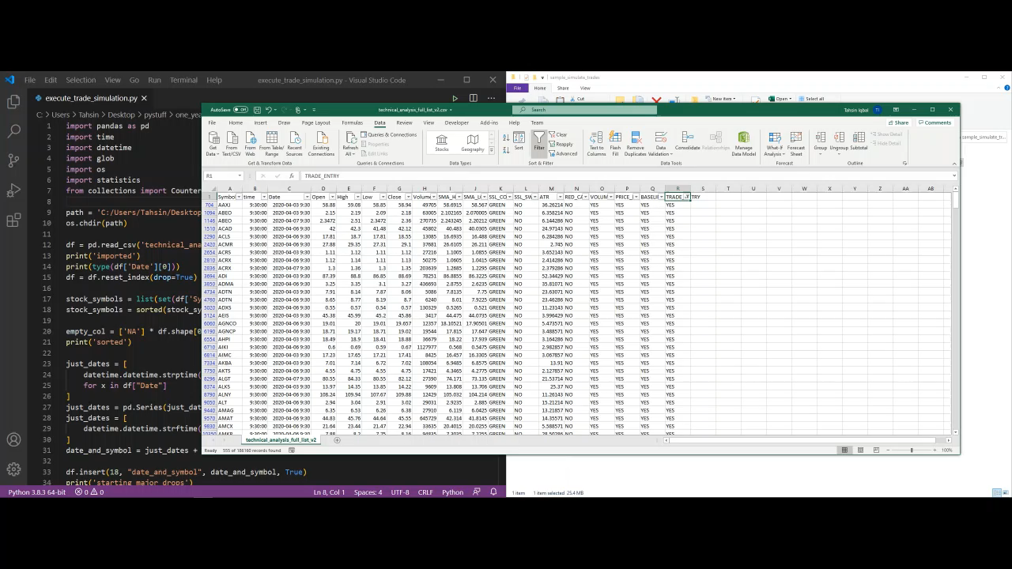
Implementation: Trade Simulations
3. Simulate trades based on technical indicators and determine the outcome

Slide 13
Analysis & Results
Category | Wins | Losses | Ties | Success rate
All Stocks | 7,731 | 16,160 | 576 | 31.5%
*High Volume Stocks | 665 | 1715 | 69 | 27.2%
*Highly Priced Stocks | 806 | 1595 | 48 | 32.3%
*Stocks with High Dollar Volume | 693 | 1696 | 60 | 28.3%
*Falls within top 10% of values
This strategy results in more losses than wins.
This is the case when looking at all stocks or when applying price and volume filters.

Slide 14
Conclusion & Next Steps
Using an increase in volume as a trade strategy did not work well for American stocks in 2019, as it only produced a success rate of about 30%.
Potential next steps:
Simulate the strategy during time period with similar market conditions (i.e. during a recession)
Attempt to modify or replace technical indicators currently used
Ex: Changing take profit and stop loss margins, adjusting settings on Gann HiLo and ATR

